Slide 1
Multiplying and dividing decimals
EQ: How do we multiply and divide decimals?

Slide 2

You will need
A4 paper
INB
Pens/pencils
Brains
Can do attitude

Slide 3
Review
Place the following in ascending order
1.356, 1.357, 1.035, 0.99
2. Solve
7.35 - 4.23
0.002+ 0.104

Slide 4
EQ: How do we multiply and divide decimals?
Topic: Multiplying and dividing decimals

Slide 5
EQ: How do we multiply and divide decimals?
Topic: Multiplying and dividing decimals
To multiply we move the numbers left.
The amount of places they move is the amount of 0s in the number we are multiplying by
Ex 3.45x 100= 345 (there are 2 0s in 100, so move two places left)
To divide we move the numbers right.
The amount of places we move them is the amount of 0s in the number we are dividing by
EX: 345 divided by 1
Multiplying
By 10,100,1000
Dividing
By 10, 100, 1000

Slide 6
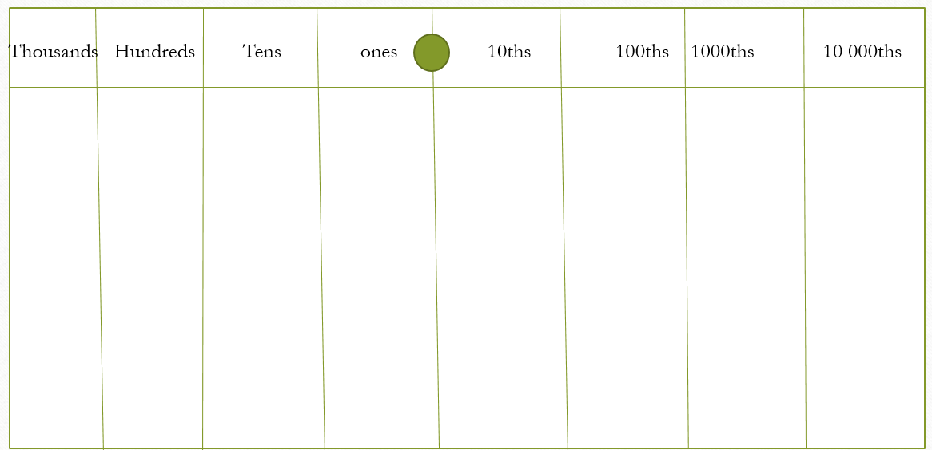
Activity
Grab a piece of paper and fold in half
Then in half again
Then in half again
Make it look like this
Cut a strip off the bottom to make small pieces of paper

Slide 7
Your paper should look like this
Thousands Hundreds Tens ones 10ths 100ths 1000ths 10 000ths

Slide 8
Lets do it!
Steps:
Place the number on the table in the correct places (use the small paper bits to make your numbers)
Count the number of 0s in 100
Move each digit to the left
Using the table work out 4.345 x 100
= 434.5
4 3 4 5
4 3 4 5

Slide 9
Try these (LHS)
3.45 x 10 b) 4.565 x 1000 c) 0.034 x 100
a) 3.45÷10 b) 4.565 ÷1000 c) 134.5 ÷100

Slide 10
EQ: How do we multiply and divide decimals?
Topic: Multiplying and dividing decimals
0.4 x 1.2
2 decimals
04
x12
48
2 decimals so divide by 100
48 ÷ 100
= 0.48
Step 1: count how many decimals there are
Step 2: write them out in correct place value and remove the decimal point
Step 3: Multiply
Step 4: divide by how many 10, 100… the number of 0 is the number of decimals
Multiplying

Slide 11
Try these
1.2 x 0.3
0.5 x 0.2
0.03 x 0.14
12.4 x 0.2
e) 15.6 x 3
f) 1.2 x 3.5
g) 0.05 x 0.2
h) 0.04 x 0.02

